Slide 1
Chapter 3 – Working environment overview
Artificial Intelligence

Slide 2
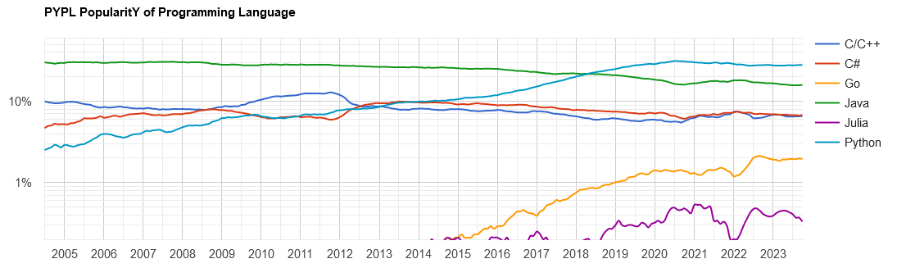
How to AI?
We’ll be using Python for AI
Why?

Slide 3
How to AI?
To do AI, you need libraries
These alle exist for Python, and are well maintained, mostly open source and extensively documented
Also, everyone is using Python these days, so why shouldn’t we?
But there are a number of ways in which to use Python:
Anaconda
Anaconda in Docker
Plain Python and pip
Virtual Environments
The cloud (aka Colab)

Slide 4
Disclaimer
The following is, at times, quite a confusing slide-deck. That is because it explains many ways of solving the same problem.
The goal is to provide an overview of what is possible. You may encounter any of these solutions in the wild. They all have their benefits.
At the end there will be another file explaining what you actually need to install.

Slide 5
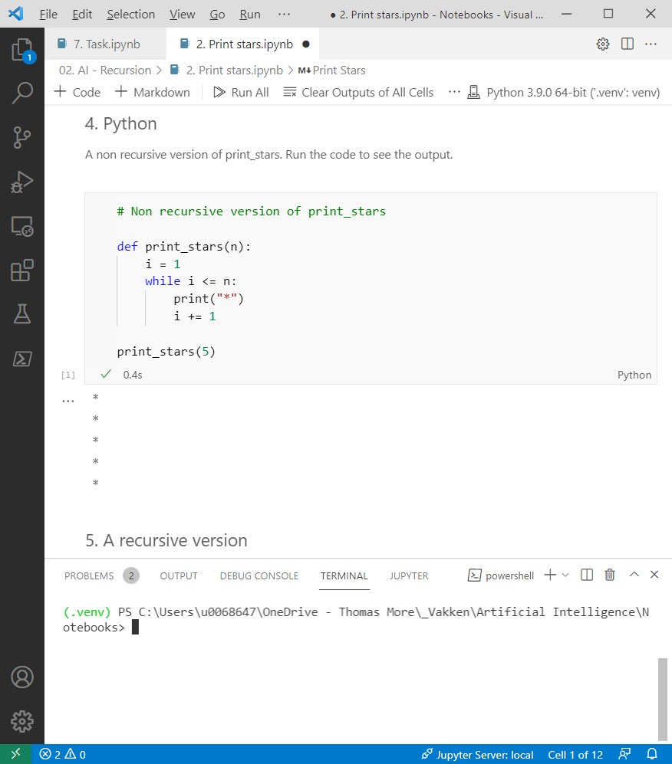
We need notebooks
Notebooks mix code and markdown-style text. This isn’t just good when creating course-material, it’s also very nice when doing AI for yourself (because you can easily document all your attempts).
You can run these in VSCode, or in PyCharm, run them from a virtual environment or from Anaconda, …

Slide 6
What is Anaconda
Anaconda is actually a package manager for Python, helping you to [un]install libraries and update them. But Anaconda is also a gui-program that you can install. In these slides, we'll usually refer to the Gui when we say "Anaconda".
Anaconda (the gui) is the industry default for Data science. Everyone uses it, so it must be good. Installation is pretty straightforward too...
Positives
Easy to install
Has all the good libraries installed by default
Packages are verified (not the case when using PIP)
Negatives
Takes over your Python-installation, forcing you to always use anaconda

Slide 7
Installation
Download the individual edition from anaconda.com
Doubleclick the installation-file, next a lot
Run the anaconda-navigator and start VSCode from there
Or start Jupyter to run notebooks in a browser

Slide 8

Visual Studio Code
VSCode is an IDE Microsoft made a couple of years ago. The idea was to create an open-source IDE that could be used for any programming language on any system.
And they succeeded.

Slide 9
What is docker?
This is. (There are non-MS-explanations, but this one nicely covers the basics.)
What is Docker?
Docker is an open-source project for automating the deployment of applications as
portable, self-sufficient containers that can run on the cloud or on-premises. Docker is
also a company that promotes and evolves this technology, working in collaboration
with cloud, Linux, and Windows vendors.
Why use docker?
Because there's a ready-made Anaconda container that simply works

Slide 10
Plusminus
Positives
Very easy to install
Doesn't take over your local Python-installation
Also has all the good libraries installed by default
Negatives
Requires an extra layer on your system
But only on Windows, in Linux, it's really fluent
A bit more work to install additional libraries

Slide 11
Anaconda in docker on a server (-cluster)
Positives
Doesn't use any processing power on your laptop
Everyone uses the same dev-environment
Really easy to deploy to racks with a lot of computing power
Negatives
You need server infrastructure (and a devops engineer) for that

Slide 12
Installation
Install Linux
Install Docker
When you run docker in windows it automatically installs the Windows Subsystem for Linux (WSL) and installs docker in there. It works nicely.
Anyway, after installing docker:
Run docker pull jupyter/datascience-notebook
Run docker run -it --rm -p 8888:8888 jupyter/datascience-notebook

Slide 13

Why?
Anaconda joins a lot of different community-efforts in one installer and packs it with a package manager (conda) that adds extra functionality (but doesn't replace pip), but you can install all these manually. This has the advantage that you can upgrade or replace any of them individually.
Positives
Very rigorous control over what get's installed and what not
Use your favorite IDE to do AI
Negatives
(A lot) more work to get everything installed and cooperating

Slide 14
How?
Download and install Python
Adding Python to the path will save you a lot of typing later
Download and install VSCode
Also download and install the Python-addons for VSCode
VSCode will suggest the good ones once you start creating files
Installing an extra library:
Open a command prompt
Go to the folder where Python is installed
E.g. C:/Users/Gebruiker/AppData/Local/Programs/Python/Python38-32/python.exe
Run python.exe -m pip install -U pandas --user

Slide 15

And Jupyter?
You can create a notebook in VSCode, but you can also work on a notebook in a browser.
You can install Jupyter as a library in Python (using pip) and run it. It wil automatically open a browser…
https://jupyter.org/install

Slide 16
The problem:
The problem:
You wrote some code half a year ago, updated Anaconda (or your libraries) and now the code doesn't work anymore because the libraries have become better (which is good), but they also changed some function-calls.
The solution:
You create a virtual environment with this Python and that library and store your project inside of that environment. When the project is done, you save the entire environment in a folder that you can reuse later on, with all the libraries in the versions you need.

Slide 17

Example
print "hello world"
print("hello world")
The first worked in Python 2 but doesn't in Python 3. Code you wrote many years ago without brackets won't work anymore.
But you want that code to work, even though it's built on older technology and relies on libraries that have been proven to be inefficient or unsafe.

Slide 18
Unsafe?
Yes, using older, not-updated libraries can be unsafe.
Yet we're not writing a new banking-App, but extracting data from files and reforming it, so working-but-not-so-safe-code is better than not-working-code.
And you're aware of the fact that you are using an old version, so every time you start a new project, you create a new environment with updated libraries and work in that environment.

Slide 19
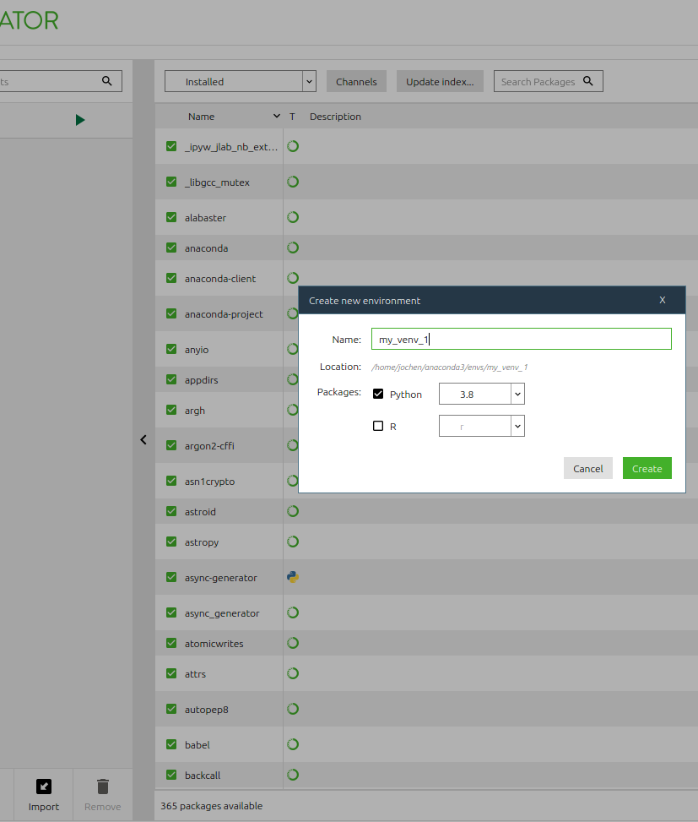
Creating a new virtual environment in Anaconda
Open Anaconda navigator
Click "Environments"
Click "Create" (at the bottom)
Call it "my_venv_1"
Spaces or special characters in the name work, but will give issues when exporting
the yaml-file.
Click "Create"

Slide 20
Using a venv in Anaconda
Select the venv in "Environments"
Go back to home, and...
Now you see the problem: the new environment is empty. You created one, but none of the libraries that Anaconda has are installed. This is unfortunate, because having these is
the big advantage in using Anaconda.
... And note how you can clone the new environment you just made, but you can't clone the base. You can, but you have to do it in the prompt.

Slide 21
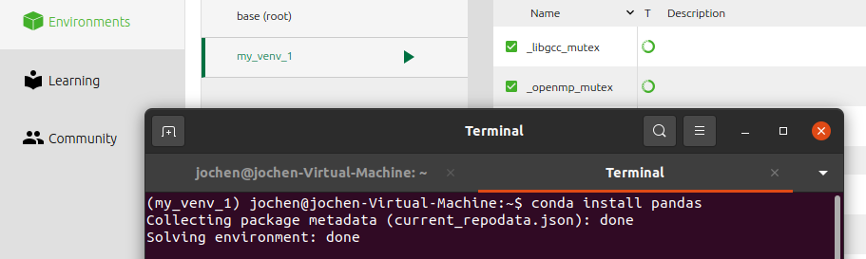
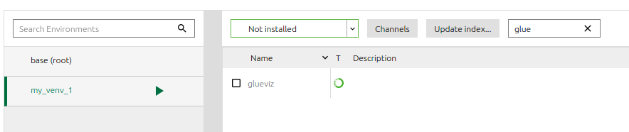
Adding a library to an environment
Using the terminal:
Click the arrow next to the environment
Select "Open Terminal“
Type:
conda install pandas
Graphically:
Select the environment
Look for the library
Use the dropdown to select
"Not installed“
Check the library
Click "Apply" at the bottom of the screen

Slide 22
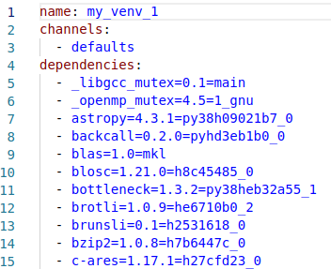
Exporting environments
Click the arrow next to the environment
Select "Open Terminal" (navigate to c:\tmp )
conda env export > environment.yml

Slide 23
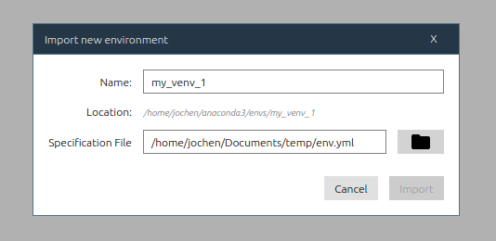
Creating a library based on a yaml-file
In anaconda, the Environments-tab:
Click "Import"
Import the yml-file

Slide 24
Using virtual environments in Python
Using virtual environments in Python is a great way of keeping a project “in working condition” and also of not installing all libraries in the basic Python-interpreter.
Create a new folder
Open VSCode in that folder (File – open folder)
In terminal, type
python -m venv venv
venv/Scripts/activate
The prompt changes to “(foldername) c:\...”

Slide 25
Do we need venv in docker?
No, when using anaconda (or Jupyter) in docker, we simply use one container per project. The Dockerfile will take care of installing the requirements. When it needs training move it over to the Kubernetes-cluster with massive GPU, when no longer working on it, store in Github.
Github, by the way: setup a continuous integration-pipeline (the CI in CI/CD) to use the same environment with dozens of developers. Works great…

Slide 26
colab.research.google.com
Google hosts a cluster of computers (a rather large one) and you can use some of that compute to run Python-code. It’s a zero-setup way of doing data science or AI.
It integrates with your google drive, which makes it easy to upload and download existing files. You can also share files this way, or even use github.

Slide 27
Running code
Plain Python, use pip for libraries
Install Anaconda
Install Jupyter notebooks
Run Jupyter in a webbrowser (Anaconda or Jupyter)
Or use VSCode (plain Python or Anaconda)
Always use virtual environments
Consider using Github
When working with more than one developer: use Github

Slide 28
How to continue?
If you’re on a shared or public device without administrator-permissions, use google colab.
If you’re on your own laptop and hope to keep on developing, try Python with VSCode. (See enclosed PDF for installation.)
If you’re already using anaconda, keep using it.

